Slide 1
UMTS Architecture

Slide 2
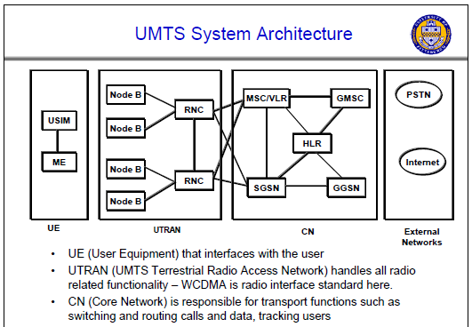
Notes:
Universität Karlsruhe
Institut für Telematik
Mobilkommunikation
SS 1998
Prof. Dr. Dr. h.c. G. Krüger
E. Dorner / Dr. J. Schiller

Slide 3
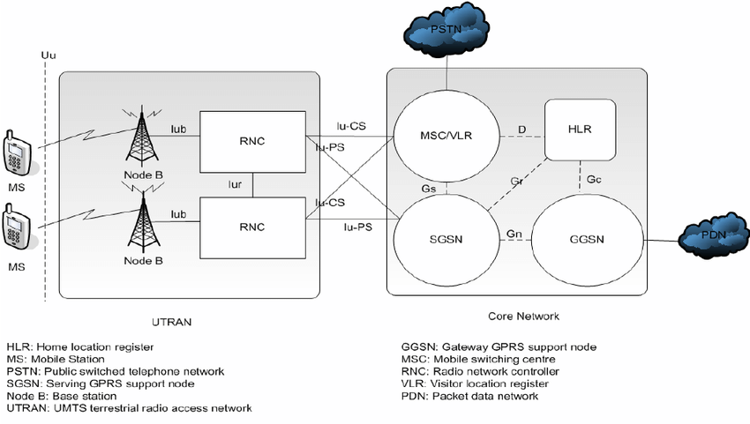

Slide 4
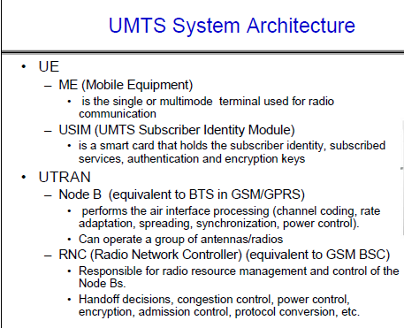
Notes:
Universität Karlsruhe
Institut für Telematik
Mobilkommunikation
SS 1998
Prof. Dr. Dr. h.c. G. Krüger
E. Dorner / Dr. J. Schiller

Slide 5
UTRAN architecture
RNS
RNC: Radio Network Controller
RNS: Radio Network Subsystem
UE₁
Node B
I_{ub}
I_{u}
RNC
CN
UE₂
Node B
Node B
UTRAN comprises several RNSs
Node B can support FDD or TDD or both
RNC is responsible for handover decisions requiring signaling to the UE
Cell offers FDD or TDD
UE₃
I_{ur}
Node B
I_{ub}
Node B
RNC
Node B
Node B
RNS
Notes:
Universität Karlsruhe
Institut für Telematik
Mobilkommunikation
SS 1998
Prof. Dr. Dr. h.c. G. Krüger
E. Dorner / Dr. J. Schiller
Universität Karlsruhe
Institut für Telematik
Mobilkommunikation
SS 1998
Prof. Dr. Dr. h.c. G. Krüger
E. Dorner / Dr. J. Schiller

Slide 6
Core network
The Core Network (CN) and thus the Interface I_{u}, too, are separated into two logical domains:
Circuit Switched Domain (CSD)
  Circuit switched service incl. signaling
  Resource reservation at connection setup
  GSM components (MSC, GMSC, VLR) are used
  I_{u}CS interface
Packet Switched Domain (PSD)
  GPRS components (SGSN, GGSN)
  I_{u}PS
Release 99 uses the GSM/GPRS network and adds a new radio access!
  Helps to save a lot of money …
  Much faster deployment
Notes:
Universität Karlsruhe
Institut für Telematik
Mobilkommunikation
SS 1998
Prof. Dr. Dr. h.c. G. Krüger
E. Dorner / Dr. J. Schiller
Universität Karlsruhe
Institut für Telematik
Mobilkommunikation
SS 1998
Prof. Dr. Dr. h.c. G. Krüger
E. Dorner / Dr. J. Schiller

Slide 7
Support of mobility: macro diversity
Multicasting of data via several physical channels
  Enables soft handover
  FDD mode only
Uplink
  simultaneous reception of UE data at several Node Bs
Downlink
  Simultaneous transmission of data via different cells
  Different spreading codes in different cells
UE
Node B
Node B
RNC
CN
Notes:
Universität Karlsruhe
Institut für Telematik
Mobilkommunikation
SS 1998
Prof. Dr. Dr. h.c. G. Krüger
E. Dorner / Dr. J. Schiller
Universität Karlsruhe
Institut für Telematik
Mobilkommunikation
SS 1998
Prof. Dr. Dr. h.c. G. Krüger
E. Dorner / Dr. J. Schiller

Slide 8

UMTS – Rake Receiver
Radio receiver
  Uses several "sub-receivers" each delayed slightly in order to tune in to the individual multipath components
  Each component decoded independently, but at a later stage combined in order to make the most use of the different transmission characteristics of each path
  Results in higher Signal-to-noise ratio (or Eb/No) in a multipath environment than in a "clean" environment
  Multipath fading is a common problem in wireless networks especially in metropoletan areas
Another “trick” to increase connection quality and reliability is macro diversity
<number> | 51
Notes:
Universität Karlsruhe
Institut für Telematik
Mobilkommunikation
SS 1998
Prof. Dr. Dr. h.c. G. Krüger
E. Dorner / Dr. J. Schiller

Slide 9
Support of mobility: handover
From and to other systems (e.g., UMTS to GSM)
  This is a must as UMTS coverage will be poor in the beginning
RNS controlling the connection is called SRNS (Serving RNS)
RNS offering additional resources (e.g., for soft handover) is called Drift RNS (DRNS)
End-to-end connections between UE and CN only via I_{u} at the SRNS
  Change of SRNS requires change of I_{u}
  Initiated by the SRNS
  Controlled by the RNC and CN
Node B
SRNC
CN
I_{ub}
I_{u}
UE
I_{ur}
Node B
DRNC
I_{ub}
Notes:
Universität Karlsruhe
Institut für Telematik
Mobilkommunikation
SS 1998
Prof. Dr. Dr. h.c. G. Krüger
E. Dorner / Dr. J. Schiller
Universität Karlsruhe
Institut für Telematik
Mobilkommunikation
SS 1998
Prof. Dr. Dr. h.c. G. Krüger
E. Dorner / Dr. J. Schiller

Slide 10
Example handover types in UMTS/GSM
UE₁
Node B₁
RNC₁
3G MSC₁
UE₂
I_{u}
Node B₂
I_{ub}
I_{ur}
UE₃
Node B₃
RNC₂
3G MSC₂
UE₄
BTS
BSC
2G MSC₃
A_{bis}
A
Notes:
Universität Karlsruhe
Institut für Telematik
Mobilkommunikation
SS 1998
Prof. Dr. Dr. h.c. G. Krüger
E. Dorner / Dr. J. Schiller

Slide 11
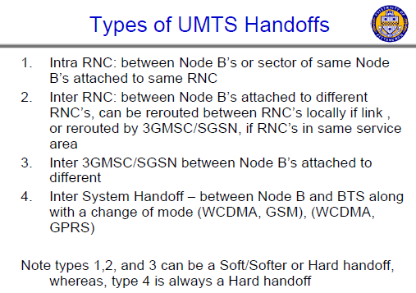
Notes:
Universität Karlsruhe
Institut für Telematik
Mobilkommunikation
SS 1998
Prof. Dr. Dr. h.c. G. Krüger
E. Dorner / Dr. J. Schiller

Slide 12
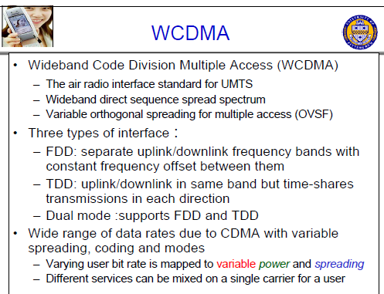
Notes:
Universität Karlsruhe
Institut für Telematik
Mobilkommunikation
SS 1998
Prof. Dr. Dr. h.c. G. Krüger
E. Dorner / Dr. J. Schiller

Slide 13
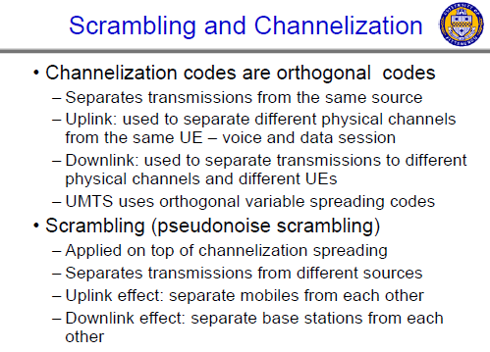
Notes:
Universität Karlsruhe
Institut für Telematik
Mobilkommunikation
SS 1998
Prof. Dr. Dr. h.c. G. Krüger
E. Dorner / Dr. J. Schiller

Slide 14
Spreading and scrambling of user data
Constant chipping rate of 3.84 Mchip/s
Different user data rates supported via different spreading factors
  higher data rate: less chips per bit and vice versa
User separation via unique, quasi orthogonal scrambling codes
  users are not separated via orthogonal spreading codes
  much simpler management of codes: each station can use the same orthogonal spreading codes
  precise synchronization not necessary as the scrambling codes stay quasi-orthogonal
data₁
data₂
data₃
data₄
data₅
spr.
code₁
spr.
code₂
spr.
code₃
spr.
code₁
spr.
code₄
scrambling
code₁
scrambling
code₂
sender₁
sender₂
Notes:
Universität Karlsruhe
Institut für Telematik
Mobilkommunikation
SS 1998
Prof. Dr. Dr. h.c. G. Krüger
E. Dorner / Dr. J. Schiller
Universität Karlsruhe
Institut für Telematik
Mobilkommunikation
SS 1998
Prof. Dr. Dr. h.c. G. Krüger
E. Dorner / Dr. J. Schiller

Slide 15
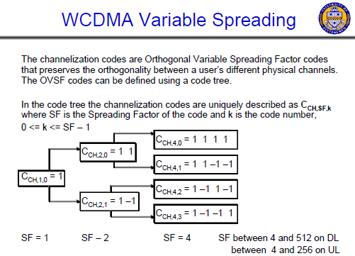
Notes:
Universität Karlsruhe
Institut für Telematik
Mobilkommunikation
SS 1998
Prof. Dr. Dr. h.c. G. Krüger
E. Dorner / Dr. J. Schiller

Slide 16
Breathing Cells
GSM
  Mobile device gets exclusive signal from the base station
  Number of devices in a cell does not influence cell size
UMTS
  Cell size is closely correlated to the cell capacity
  Signal-to-nose ratio determines cell capacity
  Noise is generated by interference from
    other cells
    other users of the same cell
  Interference increases noise level
  Devices at the edge of a cell cannot further increase their output power (max. power limit) and thus drop out of the cell
  ⇨ no more communication possible
  Limitation of the max. number of users within a cell required
  cell breathing is a mechanism which allows overloaded cells to offload subscriber traffic to neighboring cells by changing the geographic size of their service area. Heavily loaded cells decrease in size while neighboring cells increase their service area to compensate. Thus, some traffic is handed off from the overloaded cell to neighboring cells, resulting in load balancing.
Notes:
Universität Karlsruhe
Institut für Telematik
Mobilkommunikation
SS 1998
Prof. Dr. Dr. h.c. G. Krüger
E. Dorner / Dr. J. Schiller

